Slide 1
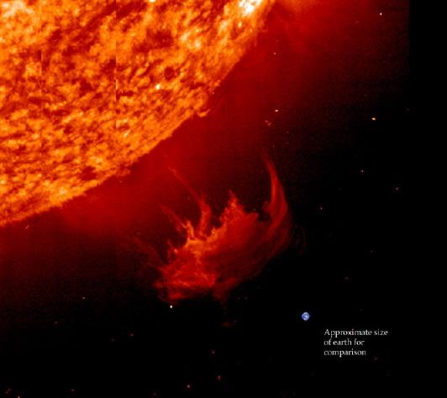
Big Data, Space Weather and cognitive visualization
Проблема больших объемов данных в космической погоде и когнитивная визуализация ("лучше один раз увидеть…!”)

Slide 2
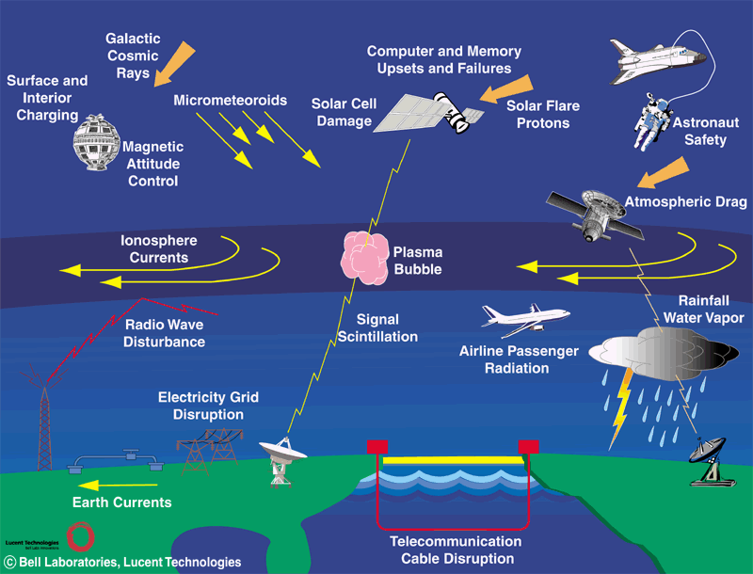
Space Weather: what is it?
OXFORD DICTIONARY: Natural processes in space that can affect the near-earth environment, satellites, and space travel, such as magnetospheric disturbances solar coronal events.
Factors of influence: cosmic rays (radiation storms), solar wind storms (CME)
Impacts:
a) Satellites, orbital stations, interplanetary missions,
b) Magnetosphere disturbance (storms) induced Faraday currents

Slide 3
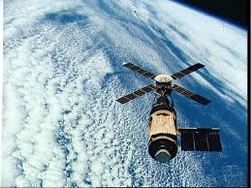
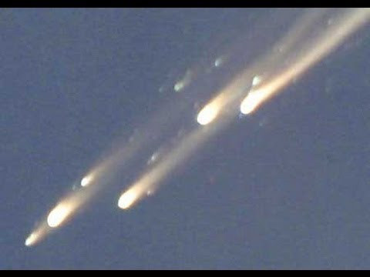
Price of space weather knowledge for space technology
Price of space technology (include space
stations) in 2013 is about
1000,000,000,000$ =10¹¹-10¹²$
Insurance claims: (800 – 1400)*10⁶ yearly
2014 year – more then 400 communication
satellites provide above 2*10⁹ users by mobile
communication + GPS
As example – crash of SkyLab mission 25 m* 7 m with loss 600 millions $$)

Slide 4
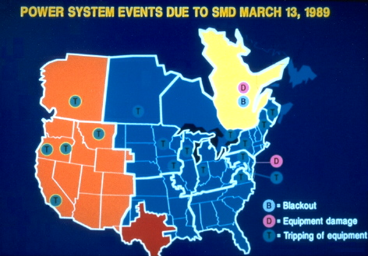
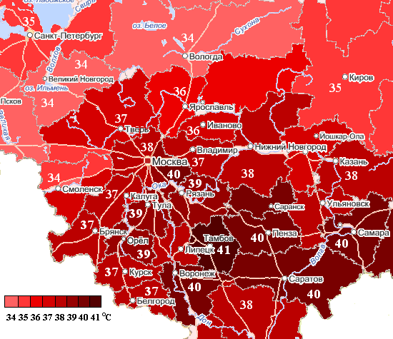
Price of space weather induced lost
Underground impacts (disruption of long way continental electric grids and communication lines): Quebec 1989 March – 6*10⁹ $
Disorder railway communication in high latitudes
Space weather – Earth weather impacts (SW-El Niño – blocked anticyclones 2010 – hot summer 2010)

Slide 5
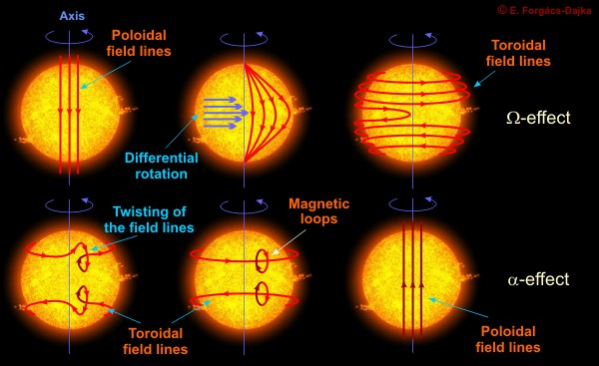
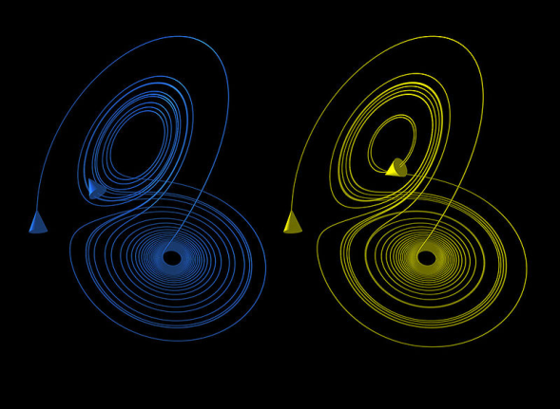
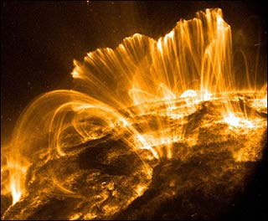
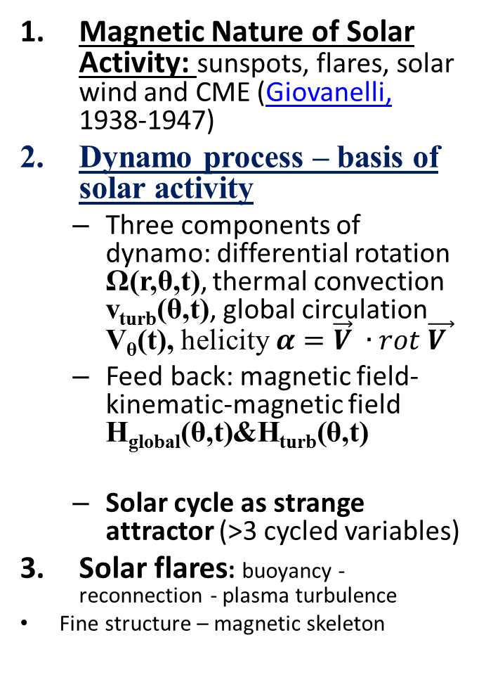
Solar Activity - Space Weather Driver
Magnetic Nature of Solar Activity: sunspots, flares, solar wind and CME (Giovanelli, 1938-1947)
Dynamo process – basis of solar activity
  Three components of dynamo: differential rotation Ω(r,θ,t), thermal convection v_{turb}(θ,t), global circulation V_{θ}(t), helicity $α=\vec{V} ∙rot \vec{V }$
  Feed back: magnetic field-kinematic-magnetic field H_{global}(θ,t)&H_{turb}(θ,t)
  Solar cycle as strange attractor (>3 cycled variables)
Solar flares: buoyancy - reconnection - plasma turbulence
Fine structure – magnetic skeleton
Ω(r,θ,t)&V_{θ}(t)&v_{turb}(θ,t)=>H_{global}(θ,t)&H_{turb}(θ,t)=>
=>Ω& V_{θ&}v_{turb}=>H_{global}&H_{turb}=>…

Slide 6
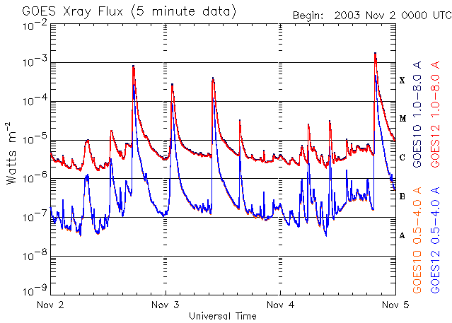
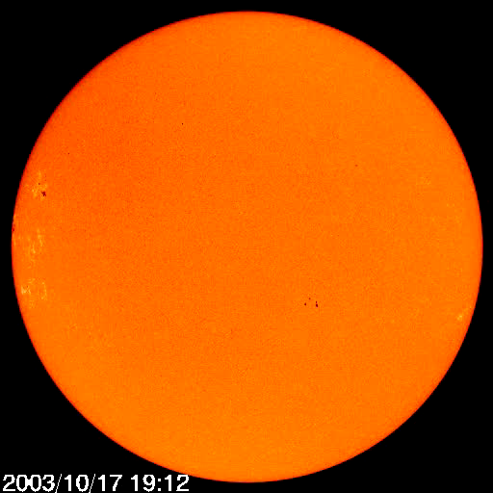
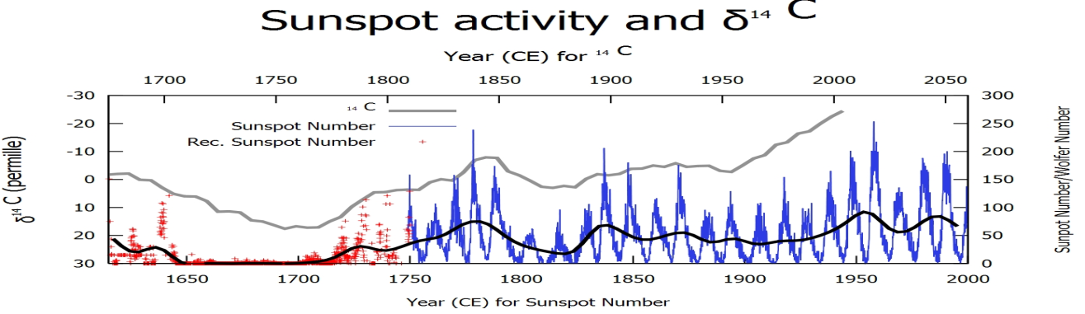
The aim of space weather research - forecasting
Prediction of solar activity on 4 time scales:
  Flares and solar CR: tens minutes-hours
    fluency: how much and when?
  Sunspots: days
    energy resource and currents level (dF/dt)
  Cycles: 9-14 years
    Global circulation and critical phase
  Feeding of activities
    (Maunder, Schperer, …) – hundreds years: Phase transition

Slide 7
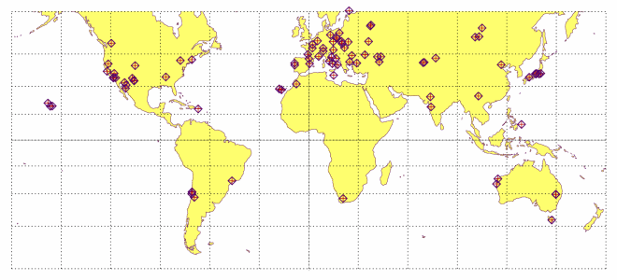
Sources of data
Solar observatory on the Earth surface
(about 120 observatories in optical emission (cont. +lines images – 100) + radio patrol (15) + radio images (few); daily data flux about 10 Terabyte daily
Space located solar observatories satellites in L1 point: (opt. and UV each hour-15minutes): SOHO, SDO, TRACE, FAST, HINODE,… - 1 terabyte daily
Space plasma and field measuring by interplanetary stations: TWINS, WIND, VOYAGERS (2), … - 10 Gigabyte daily
Near Earth Space (magnetosphere, ionosphere, high atmosphere) – CLUSTER(4), THEMIS, TIMED, GOES(14), … - 1 Gigabyte daily
Application (geophysical, atmospheric, ground images (military and civil) – 10 Terbytedaily
USED in practice: 1%-3%
=> Big Data Problem

Slide 8
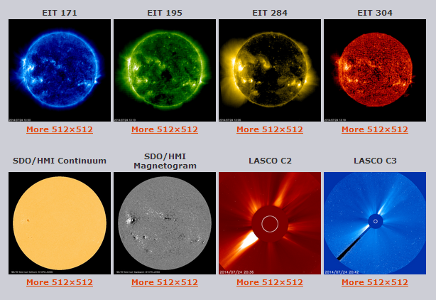
Standard approach (compactification in 1000,000 times!)
SOHO LASCO CME CATALOG
Images => catalog of 10 key parameters (sunspots position, area, number, coronal holes, flares (forms, position, classes, dynamics)
Light curves (moments of events, dynamic parameter) => catalog
YEAR | MONTH
1996 | Jan | Feb | Mar | Apr | May | Jun | Jul | Aug | Sep | Oct | Nov | Dec
1997 | Jan | Feb | Mar | Apr | May | Jun | Jul | Aug | Sep | Oct | Nov | Dec
1998 | Jan | Feb | Mar | Apr | May | Jun | Jul | Aug | Sep | Oct | Nov | Dec
1999 | Jan | Feb | Mar | Apr | May | Jun | Jul | Aug | Sep | Oct | Nov | Dec
2000 | Jan | Feb | Mar | Apr | May | Jun | Jul | Aug | Sep | Oct | Nov | Dec
2001 | Jan | Feb | Mar | Apr | May | Jun | Jul | Aug | Sep | Oct | Nov | Dec
2002 | Jan | Feb | Mar | Apr | May | Jun | Jul | Aug | Sep | Oct | Nov | Dec
2003 | Jan | Feb | Mar | Apr | May | Jun | Jul | Aug | Sep | Oct | Nov | Dec
2004 | Jan | Feb | Mar | Apr | May | Jun | Jul | Aug | Sep | Oct | Nov | Dec
2005 | Jan | Feb | Mar | Apr | May | Jun | Jul | Aug | Sep | Oct | Nov | Dec
2006 | Jan | Feb | Mar | Apr | May | Jun | Jul | Aug | Sep | Oct | Nov | Dec
2007 | Jan | Feb | Mar | Apr | May | Jun | Jul | Aug | Sep | Oct | Nov | Dec
2008 | Jan | Feb | Mar | Apr | May | Jun | Jul | Aug | Sep | Oct | Nov | Dec
2009 | Jan | Feb | Mar | Apr | May | Jun | Jul | Aug | Sep | Oct | Nov | Dec
2010 | Jan | Feb | Mar | Apr | May | Jun | Jul | Aug | Sep | Oct | Nov | Dec
2011 | Jan | Feb | Mar | Apr | May | Jun | Jul | Aug | Sep | Oct | Nov | Dec
2012 | Jan | Feb | Mar | Apr | May | Jun | Jul | Aug | Sep | Oct | Nov | Dec
2013 | Jan | Feb | Mar | Apr | May | Jun | Jul | Aug | Sep | Oct | Nov | Dec

Slide 10
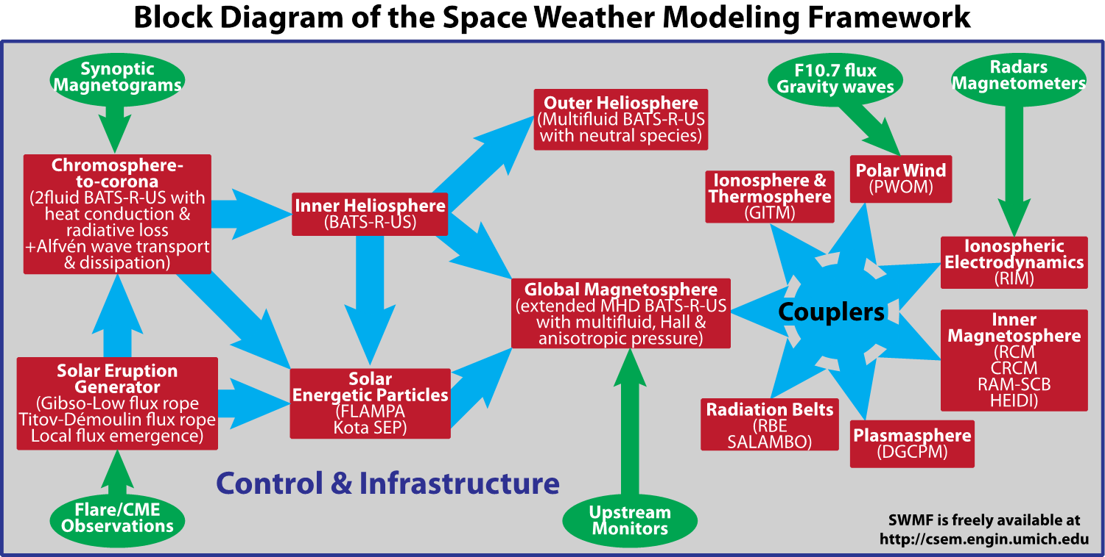
Attempts of cognitive automatically analysis (as researcher)
1. Automatically Space Weather modelling (in real time): Tamas Gombosi - NASA

Slide 11

Using A-Priori physics after flare
For example: solar cosmic ray propagation – diffusion process$F(t)\sim \left(\frac{1}{\sqrt{t}}\right)e^{−\left({x^{2}}/t\right)}$
Preceding time: 30 min- few hours

Slide 12
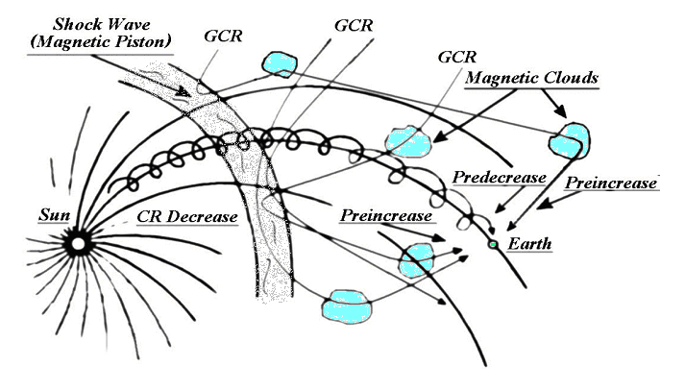

Slide 13
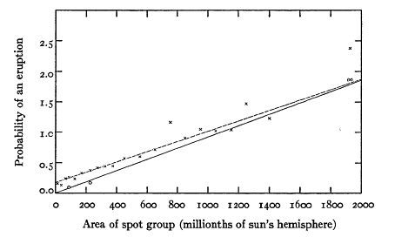
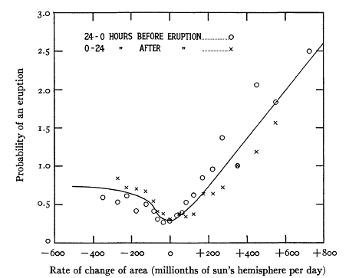
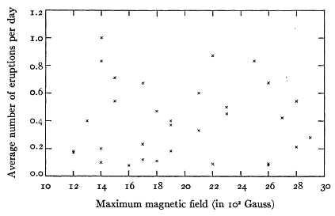
Giovanelli – father of magnetic reconnection in flare
1938 – student (Australia) – said “a” (ApJ, 1939,June, 89-5-555
1947 – Nature (2 pages)+MNRAS (1947,107, 338-355) – “я”
“MAGNETIC AND ELECTRIC PHENOMENA IN THE SUN’S ATMOSPHERE ASSOTIATED WITH SUNSPOTS” – flare energy release is DISCHARGE
back

